Slide 1
Lecture 3
Autoregressive Distributed Lag Models

Slide 2
9.6
Autoregressive Distributed Lag Models

Slide 3
9.6
Autoregressive Distributed Lag Models
An autoregressive distributed lag (ARDL) model is one that contains both lagged x_{t}’s and lagged y_{t}’s
Two examples:
Eq. 9.52

Slide 4
9.6
Autoregressive Distributed Lag Models
An ARDL model can be transformed into one with only lagged x’s which go back into the infinite past:
This model is called an infinite distributed lag model
Eq. 9.53

Slide 5
9.6
Autoregressive Distributed Lag Models
Four possible criteria for choosing p and q:
Has serial correlation in the errors been eliminated?
Are the signs and magnitudes of the estimates consistent with our expectations from economic theory?
Are the estimates significantly different from zero, particularly those at the longest lags?
What values for p and q minimize information criteria such as the AIC and SC?

Slide 6
9.6
Autoregressive Distributed Lag Models
The Akaike information criterion (AIC) is:
where K = p + q + 2
The Schwarz criterion (SC), also known as the Bayes information criterion (BIC), is:
Because Kln(T)/T > 2K/T for T ≥ 8, the SC penalizes additional lags more heavily than does the AIC
Eq. 9.54
Eq. 9.55

Slide 7
9.6
Autoregressive Distributed Lag Models
9.6.1
The Phillips Curve
Consider the previously estimated ARDL(1,0) model:
Eq. 9.56

Slide 8
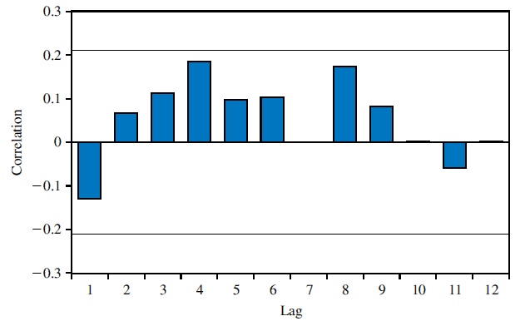
9.6
Autoregressive Distributed Lag Models
FIGURE 9.9 Correlogram for residuals from Phillips curve ARDL(1,0) model
9.6.1
The Phillips Curve

Slide 9
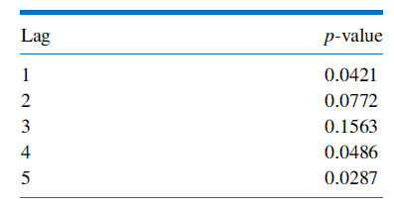
9.6
Autoregressive Distributed Lag Models
Table 9.3 p-values for LM Test for Autocorrelation
9.6.1
The Phillips Curve

Slide 10
9.6
Autoregressive Distributed Lag Models
9.6.1
The Phillips Curve
For an ARDL(4,0) version of the model:
Eq. 9.57

Slide 11
9.6
Autoregressive Distributed Lag Models
9.6.1
The Phillips Curve
Inflation is given by:

Slide 12
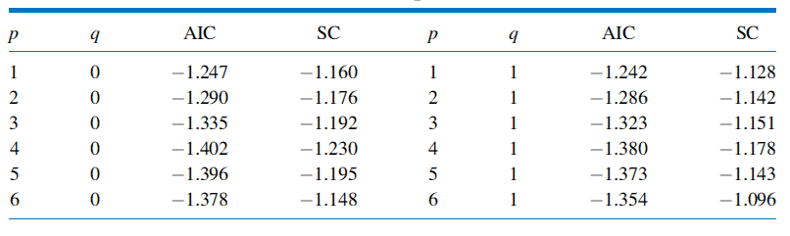
9.6
Autoregressive Distributed Lag Models
Table 9.4 AIC and SC Values for Phillips Curve ARDL Models
9.6.1
The Phillips Curve

Slide 13
9.6
Autoregressive Distributed Lag Models
9.6.2
Okun’s Law
Recall the model for Okun’s Law:
Eq. 9.58

Slide 14
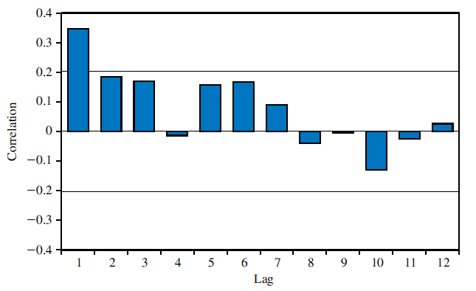
9.6
Autoregressive Distributed Lag Models
FIGURE 9.10 Correlogram for residuals from Okun’s law ARDL(0,2) model
9.6.2
Okun’s Law

Slide 15
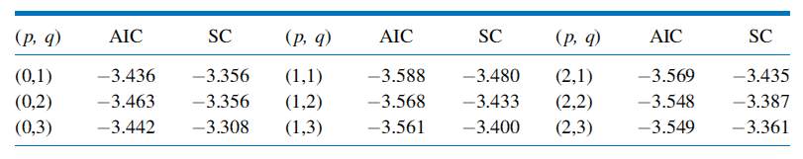
9.6
Autoregressive Distributed Lag Models
Table 9.5 AIC and SC Values for Okun’s Law ARDL Models
9.6.2
Okun’s Law

Slide 16
9.6
Autoregressive Distributed Lag Models
9.6.2
Okun’s Law
Now consider this version:
Eq. 9.59

Slide 17
9.6
Autoregressive Distributed Lag Models
9.6.3
Autoregressive Models
An autoregressive model of order p, denoted AR(p), is given by:
Eq. 9.60

Slide 18
9.6
Autoregressive Distributed Lag Models
9.6.3
Autoregressive Models
Consider a model for growth in real GDP:
Eq. 9.61

Slide 19
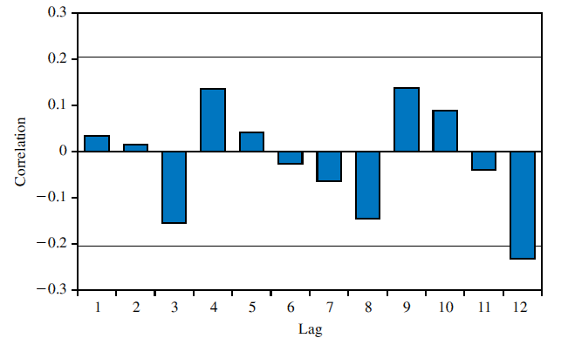
9.6
Autoregressive Distributed Lag Models
FIGURE 9.11 Correlogram for residuals from AR(2) model for GDP growth
9.6.3
Autoregressive Models

Slide 20
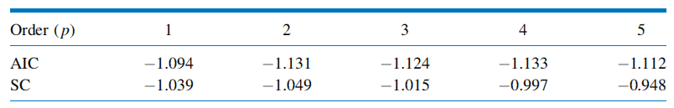
9.6
Autoregressive Distributed Lag Models
Table 9.6 AIC and SC Values for AR Model of Growth in U.S. GDP
9.6.3
Autoregressive Models

Slide 21
9.7
Forecasting

Slide 22
9.7
Forecasting
We consider forecasting using two different models:
AR model
ARDL model

Slide 23
9.7
Forecasting
9.7.1
Forecasting with an AR Model
Consider an AR(2) model for real GDP growth:
The model to forecast G_{T+1} is:
Eq. 9.62

Slide 24
9.7
Forecasting
9.7.1
Forecasting with an AR Model
The growth values for the two most recent quarters are:
G_{T} = G_{2009Q3} = 0.8
G_{T-1} = G_{2009Q2} = -0.2
The forecast for G_{2009Q4} is:
Eq. 9.63

Slide 25
9.7
Forecasting
9.7.1
Forecasting with an AR Model
For two quarters ahead, the forecast for G_{2010Q1} is:
For three periods out, it is:
Eq. 9.64
Eq. 9.65

Slide 26
9.7
Forecasting
9.7.1
Forecasting with an AR Model
Summarizing our forecasts:
Real GDP growth rates for 2009Q4, 2010Q1, and 2010Q2 are approximately 0.72%, 0.93%, and 0.99%, respectively

Slide 27
9.7
Forecasting
9.7.1
Forecasting with an AR Model
A 95% interval forecast for j periods into the future is given by:
where is the standard error of the forecast error and df is the number of degrees of freedom in the estimation of the AR model

Slide 28
9.7
Forecasting
9.7.1
Forecasting with an AR Model
The first forecast error, occurring at time T+1, is:
Ignoring the error from estimating the coefficients, we get:
Eq. 9.66

Slide 29
9.7
Forecasting
9.7.1
Forecasting with an AR Model
The forecast error for two periods ahead is:
The forecast error for three periods ahead is:
Eq. 9.67
Eq. 9.68

Slide 30
9.7
Forecasting
9.7.1
Forecasting with an AR Model
Because the v_{t}’s are uncorrelated with constant variance , we can show that:

Slide 31
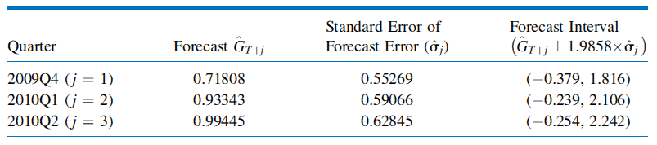
9.7
Forecasting
Table 9.7 Forecasts and Forecast Intervals for GDP Growth
9.7.1
Forecasting with an AR Model

Slide 32
9.7
Forecasting
9.7.2
Forecasting with an ARDL Model
Consider forecasting future unemployment using the Okun’s Law ARDL(1,1):
The value of DU in the first post-sample quarter is:
But we need a value for G_{T+1}
Eq. 9.69
Eq. 9.70

Slide 33
9.7
Forecasting
9.7.2
Forecasting with an ARDL Model
Now consider the change in unemployment
Rewrite Eq. 9.70 as:
Rearranging:
Eq. 9.71

Slide 34
9.7
Forecasting
9.7.2
Forecasting with an ARDL Model
For the purpose of computing point and interval forecasts, the ARDL(1,1) model for a change in unemployment can be written as an ARDL(2,1) model for the level of unemployment
This result holds not only for ARDL models where a dependent variable is measured in terms of a change or difference, but also for pure AR models involving such variables

